Slide 1
Building a Compassionate Community
Fall 2016
Clinton Community School District

Slide 2
Overview
8
PARTICIPATION OPEN BETWEEN
September 15, 2016
THOUGHTEXCHANGE PROCESSES
TO
Including Students, Parents, Guardians, Staff Members, Community Members, and Others
October 14, 2016

Slide 3
Overview – Questions Parents & Staff
What are your thoughts on our policies around bullying and the ways that we address bullying in our school or school district?
What are some examples of other ways we could address bullying and build a compassionate student community?
What are your thoughts or questions on how student mental health is supported in our school or school district?
Is there anything else you would like to add?

Slide 4
Overview – Questions Students
What are your thoughts on our rules about bullying and the ways we address bullying in our schools?
What are some important things we need to consider when we address bullying?

Slide 5
Participation Numbers
# People
#Ideas
Passion for the Idea
2,521
2,996
102,734
PEOPLE PARTICIPATED
THOUGHTS CONTRIBUTED
STARS ASSIGNED

Slide 6
Largest Conversations
A need to recognize and define bullying
A need to enforce policies consistently
A need for staff to intervene in a consistent manner
A need for parents to get involved; mentor and counsel
A need for counseling services, more support and resources

Slide 7
Largest Conversations - Students
A real anti-bullying sentiment
They recognize that there is a link between bullying and mental health
Conflict between reporting an incident and consequences
Want fairness from staff when dispensing discipline – hearing both sides
Do seek stricter punishments and consequences

Slide 8
Policy on Bullying. In reading the student handbook on anti-bullying and harassment, it appears that this is an issue the school takes very seriously and strives to ensure that our students are kept in a safe and educational environment.

Slide 9
Keep At It. Continue the work of bringing awareness to bullying and mental health. Strive to continue caring about the "whole" student: educational, emotional, relational, and physical. Thanks goes to administration, teachers and staff for dedicating your careers to our children.

Slide 10
I think the rules about bullying are pretty fair. Also, the way our school addresses bullying problems is organized and helpful.

Slide 11
Accepting. I think we need to work on accepting everyone for who they are. Whether they struggle academically or socially we need to try our best to stop it.

Slide 12
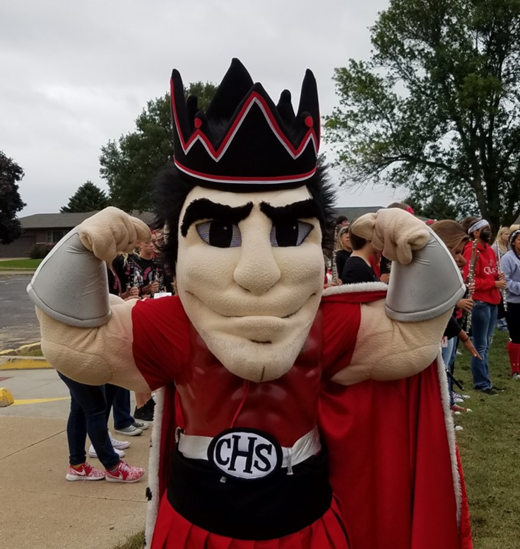
Next Steps – Taking Action
Review results by building and with each stake-holder group
Questions for further analysis
Determine as a district or school, what steps should be addressed from survey results

